Slide 1
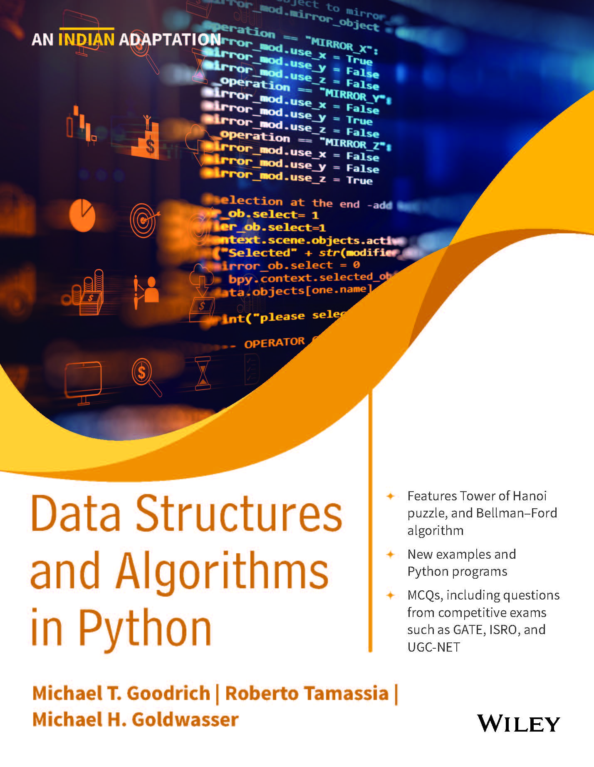
Data Structures and Algorithms in Python
Michael T. Goodrich/ Roberto Tamassia/ Michael H. Goldwasser
Adapted by Subhrakanta Panda
Chapter 9
Trees
© 2021 Goodrich, Tamassia, Goldwasser

Slide 2
Trees
Make Money Fast!
Stock
Fraud
Ponzi
Scheme
Bank
Robbery
© 2021 Goodrich, Tamassia, Goldwasser
Trees
Notes:
Trees

Slide 3
What is a Tree
In computer science, a tree is an abstract model of a hierarchical structure
A tree consists of nodes with a parent-child relation
Applications:
  Organization charts
  File systems
  Programming environments
Computers”R”Us
Sales
Manufacturing
R&D
US
International
Laptops
Desktops
Europe
Asia
Canada
© 2021 Goodrich, Tamassia, Goldwasser
Trees

Slide 4
Tree Terminology
Root: node without parent (A)
Internal node: node with at least one child (A, B, C, F)
External node (a.k.a. leaf ): node without children (E, I, J, K, G, H, D)
Ancestors of a node: parent, grandparent, grand-grandparent, etc.
Depth of a node: number of ancestors
Height of a tree: maximum depth of any node (3)
Descendant of a node: child, grandchild, grand-grandchild, etc.
Subtree: tree consisting of a node and its descendants
A
subtree
B
C
D
E
F
G
H
I
J
K
© 2021 Goodrich, Tamassia, Goldwasser
Trees

Slide 5
Tree ADT
We use positions to abstract nodes
Generic methods:
  Integer len()
  Boolean is_empty()
  Iterator positions()
  Iterator iter()
Accessor methods:
  position root()
  position parent(p)
  Iterator children(p)
  Integer num_children(p)
Query methods:
  Boolean is_leaf(p)
  Boolean is_root(p)
Update method:
  element replace (p, o)
Additional update methods may be defined by data structures implementing the Tree ADT
© 2021 Goodrich, Tamassia, Goldwasser
Trees

Slide 6
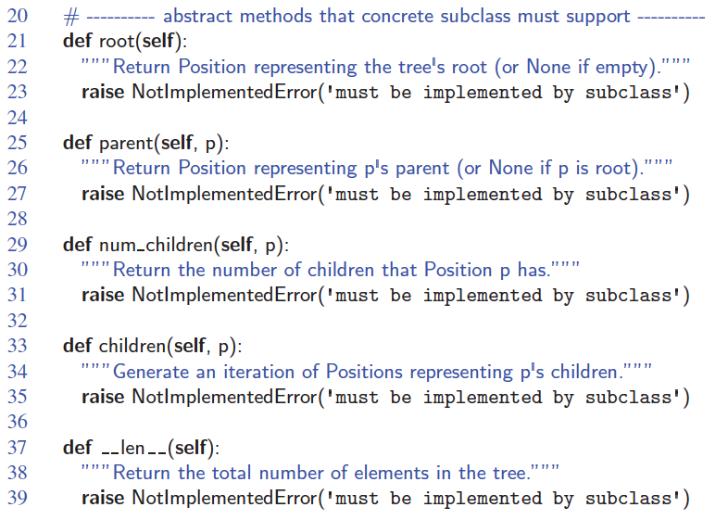
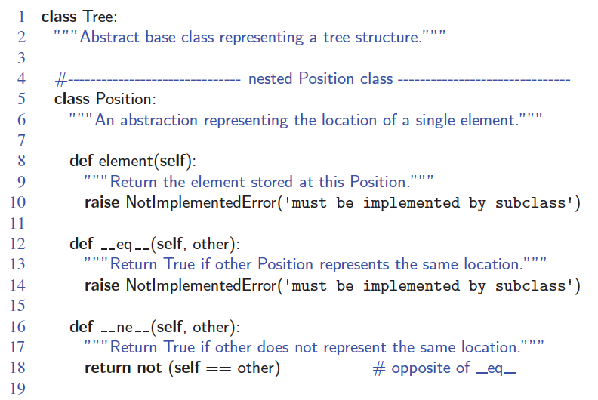
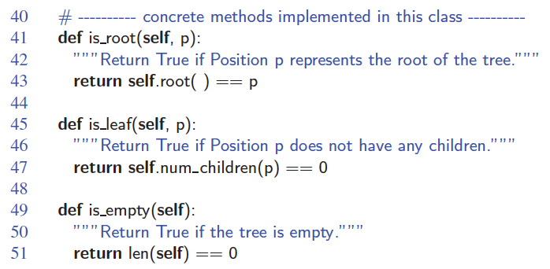
Abstract Tree Class in Python
© 2021 Goodrich, Tamassia, Goldwasser
Trees

Slide 7
Binary Trees
A binary tree is a tree with the following properties:
  Each internal node has at most two children (exactly two for proper binary trees)
  The children of a node are an ordered pair
We call the children of an internal node left child and right child
Alternative recursive definition: a binary tree is either
  a tree consisting of a single node, or
  a tree whose root has an ordered pair of children, each of which is a binary tree
Applications:
  arithmetic expressions
  decision processes
  searching
A
B
C
D
E
F
G
H
I
© 2021 Goodrich, Tamassia, Goldwasser
Trees

Slide 8
Arithmetic Expression Tree
Binary tree associated with an arithmetic expression
  internal nodes: operators
  external nodes: operands
Example: arithmetic expression tree for the expression (2 × (a − 1) + (3 × b))
+
×
×
2
−
3
b
a
1
© 2021 Goodrich, Tamassia, Goldwasser
Trees

Slide 9
Decision Tree
Binary tree associated with a decision process
  internal nodes: questions with yes/no answer
  external nodes: decisions
Example: dining decision
Want a fast meal?
Yes
No
How about coffee?
On expense account?
Yes
No
Yes
No
Starbucks
Spike’s
Al Forno
Café Paragon
© 2021 Goodrich, Tamassia, Goldwasser
Trees

Slide 10
BinaryTree ADT
The BinaryTree ADT extends the Tree ADT, i.e., it inherits all the methods of the Tree ADT
Additional methods:
  position left(p)
  position right(p)
  position sibling(p)
Update methods may be defined by data structures implementing the BinaryTree ADT
© 2021 Goodrich, Tamassia, Goldwasser
Trees

Slide 11
Properties of Proper Binary Trees
Notation
  n number of nodes
  e number of external nodes
  i number of internal nodes
  h height
Properties:
  e = i + 1
  n = 2e − 1
  h ≤ i
  h ≤ (n − 1)/2
  e ≤ 2^{h}
  h ≥ log₂ e
  h ≥ log₂ (n + 1) − 1
© 2021 Goodrich, Tamassia, Goldwasser
Trees

Slide 12
Linked Structure for Binary Trees
A node is represented by an object storing
  Element
  Parent node
  Left child node
  Right child node
Node objects implement the Position ADT
∅
B
∅
∅
B
A
D
A
D
∅
∅
∅
∅
C
E
C
E
© 2021 Goodrich, Tamassia, Goldwasser
Trees

Slide 13
Array-Based Representation of Binary Trees
Nodes are stored in an array A
1
A
A
B
D
…
G
H
…
2
3
0
1
2
3
10
11
B
D
Node v is stored at A[rank(v)]
  rank(root) = 1
  if node is the left child of parent(node), rank(node) = 2 ⋅ rank(parent(node))
  if node is the right child of parent(node), rank(node) = 2 ⋅ rank(parent(node)) + 1
4
5
6
7
E
F
C
J
10
11
G
H
© 2021 Goodrich, Tamassia, Goldwasser
Trees

Slide 14
Linked Structure for Trees
A node is represented by an object storing
  Element
  Parent node
  Sequence of children nodes
Node objects implement the Position ADT
∅
B
∅
∅
A
D
F
B
A
D
F
C
E
∅
∅
C
E
© 2021 Goodrich, Tamassia, Goldwasser
Trees

Slide 15
Inorder Traversal
In an inorder traversal a node is visited after its left subtree and before its right subtree
Application: draw a binary tree
  x(v) = inorder rank of v
  y(v) = depth of v
Algorithm inOrder(v)
  if v has a left child
    inOrder (left (v))
  visit(v)
  if v has a right child
    inOrder (right (v))
6
2
8
1
4
7
9
3
5
© 2021 Goodrich, Tamassia, Goldwasser
Trees

Slide 16
Preorder Traversal
A traversal visits the nodes of a tree in a systematic manner
In a preorder traversal, a node is visited before its descendants
Application: print a structured document
Algorithm preOrder(v)
  visit(v)
  for each child w of v
  preorder (w)
1
Make Money Fast!
2
5
9
1. Motivations
2. Methods
References
3
4
6
7
8
1.1 Greed
1.2 Avidity
2.1 Stock
Fraud
2.2 Ponzi
Scheme
2.3 Bank
Robbery
© 2021 Goodrich, Tamassia, Goldwasser
Trees

Slide 17
Postorder Traversal
In a postorder traversal, a node is visited after its descendants
Application: compute space used by files in a directory and its subdirectories
Algorithm postOrder(v)
  for each child w of v
  postOrder (w)
  visit(v)
9
cs16/
8
3
7
homeworks/
programs/
todo.txt
1K
1
2
4
5
6
h1c.doc
3K
h1nc.doc
2K
DDR.java
10K
Stocks.java
25K
Robot.java
20K
© 2021 Goodrich, Tamassia, Goldwasser
Trees

Slide 18
Print Arithmetic Expressions
Specialization of an inorder traversal
  print operand or operator when visiting node
  print “(“ before traversing left subtree
  print “)“ after traversing right subtree
Algorithm printExpression(v)
  if v has a left child
  print(“(’’)
    inOrder (left(v))
  print(v.element ())
  if v has a right child
    inOrder (right(v))
  print (“)’’)
+
×
×
2
−
3
b
((2 × (a − 1)) + (3 × b))
a
1
© 2021 Goodrich, Tamassia, Goldwasser
Trees

Slide 19
Evaluate Arithmetic Expressions
Specialization of a postorder traversal
  recursive method returning the value of a subtree
  when visiting an internal node, combine the values of the subtrees
Algorithm evalExpr(v)
  if is_leaf (v)
    return v.element ()
  else
  x ← evalExpr(left (v))
  y ← evalExpr(right (v))
  ◊ ← operator stored at v
    return x ◊ y
+
×
×
2
−
3
2
5
1
© 2021 Goodrich, Tamassia, Goldwasser
Trees

Slide 20
Euler Tour Traversal
Generic traversal of a binary tree
Includes a special cases the preorder, postorder and inorder traversals
Walk around the tree and visit each node three times:
  on the left (preorder)
  from below (inorder)
  on the right (postorder)
+
L
×
R
×
B
2
−
3
2
5
1
© 2021 Goodrich, Tamassia, Goldwasser
Trees

